Slide 1
Deep learning Auto encoders

Slide 2
What are Autoencoders?
An autoencoder neural network is an Unsupervised Machine learning algorithm that is designed to receive an input and transform it into a different representation. Autoencoders can be used to compress the data and reduce its dimensionality.
Autoencoders are a specific type of feedforward neural networks where the input is the same as the output. They compress the input into a lower-dimensional code and then reconstruct the output from this representation. The code is a compact “summary” or “compression” of the input, also called the latent-space representation.

Slide 3
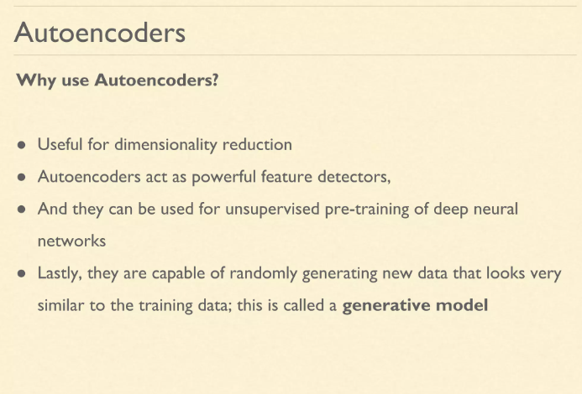

Slide 4
Architecture
An Autoencoder consists of three layers:
Encoder : It compresses the input image into a latent space representation. It encodes the input image as a compressed representation in a reduced dimension. The compressed image is a distorted version of the original image.
Code : The Code layer represents the compressed input fed to the decoder layer.
Decoder : This layer decodes the encoded image back to the original dimension. The decoded image is a lossy reconstruction of the original image and it is reconstructed from the latent space representation.
The layer between the encoder and decoder, ie. the code is also known as Bottleneck.

Slide 5
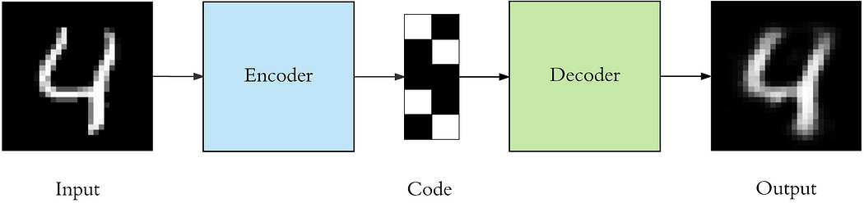
Architecture
The encoder compresses the input and produces the code, the decoder then reconstructs the input only using this code.
To build an autoencoder we need 3 things: an encoding method, decoding method, and a loss function to compare the output with the target.

Slide 6
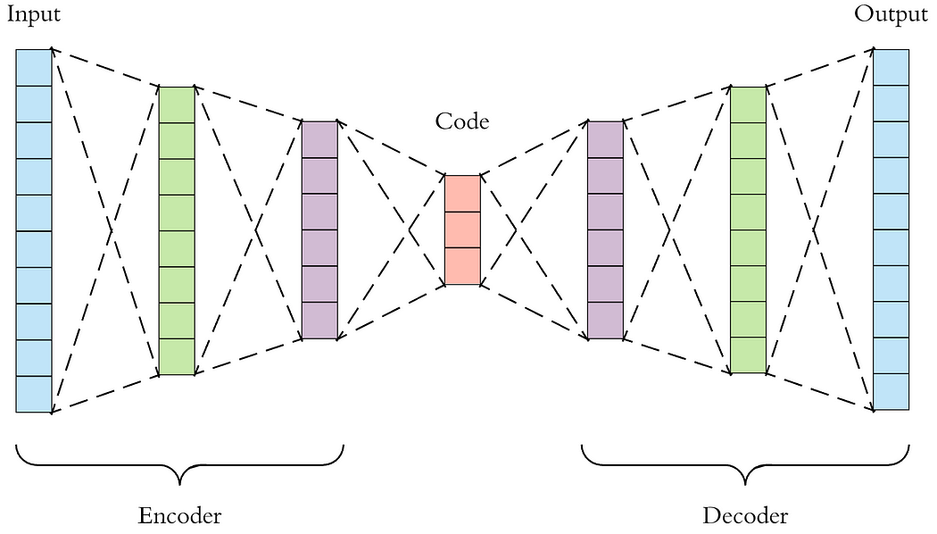
Architecture
Both the encoder and decoder are fully-connected feedforward neural networks.
Code is a single layer of an ANN with the dimensionality of our choice. The number of nodes in the code layer is a hyperparameter that we set before training the autoencoder.
Fig. Detailed visualization of an autoencoder

Slide 7
Architecture
First the input passes through the encoder, which is a fully-connected ANN, to produce the code.
The decoder, which has the similar ANN structure, then produces the output only using the code.
The goal is to get an output identical with the input.
Note that the decoder architecture is the mirror image of the encoder. The only requirement is the dimensionality of the input and output needs to be the same.

Slide 8
Properties and Hyperparameters
Properties of Autoencoders:
Data-specific: Autoencoders are only able to compress data similar to what they have been trained on.
Lossy: The decompressed outputs will be degraded compared to the original inputs.
Learned automatically from examples: It is easy to train specialized instances of the algorithm that will perform well on a specific type of input.

Slide 9
Properties and Hyperparameters
Hyperparameters of Autoencoders: There are 4 hyperparameters that we need to set before training an autoencoder:
Code size: It represents the number of nodes in the middle layer. Smaller size results in more compression.
Number of layers: The autoencoder can consist of as many layers as we want.
Number of nodes per layer: The number of nodes per layer decreases with each subsequent layer of the encoder, and increases back in the decoder. The decoder is symmetric to the encoder in terms of the layer structure.
Loss function: We either use mean squared error or binary cross-entropy. If the input values are in the range [0, 1] then we typically use cross entropy, otherwise, we use the mean squared error.

Slide 10
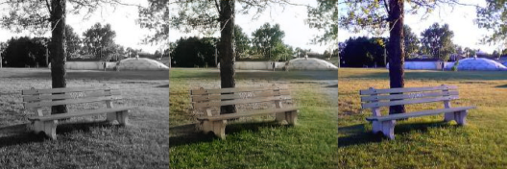
Applications of Autoencoders
Image Coloring
Autoencoders are used for converting any black and white picture into a colored image. Depending on what is in the picture, it is possible to tell what the color should be.

Slide 11
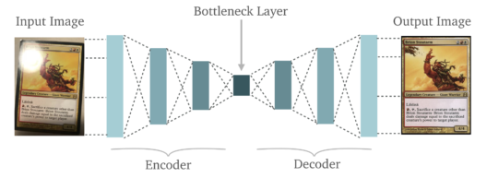
Applications of Autoencoders
Feature variation
It extracts only the required features of an image and generates the output by removing any noise or unnecessary interruption.

Slide 12
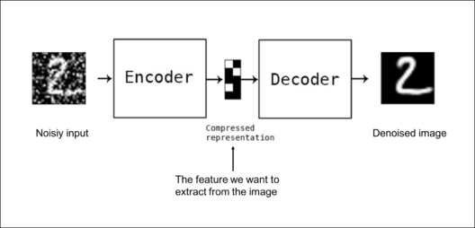
Applications of Autoencoders
Denoising Image
The input seen by the autoencoder is not the raw input but a stochastically corrupted version. A denoising autoencoder is thus trained to reconstruct the original input from the noisy version.

Slide 13
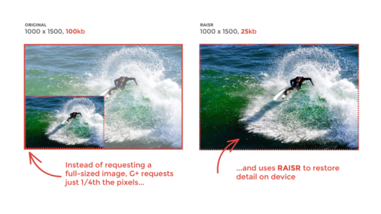
Applications of Autoencoders
Dimensionality Reduction
The reconstructed image is the same as our input but with reduced dimensions. It helps in providing the similar image with a reduced pixel value.

Slide 14
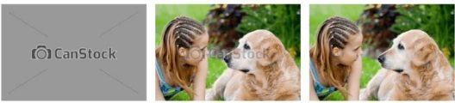
Applications of Autoencoders
Watermark Removal
It is also used for removing watermarks from images or to remove any object while filming a video or a movie.

Slide 15
Types of Autoencoders
Initially used for dimensionality reduction and feature learning, an autoencoder concept has evolved over the years and is now widely used for learning generative models of data.
Here are five popular autoencoders:
Denoising autoencoders
Sparse autoencoders
Deep autoencoders
Variational Autoencoders (for generative modelling)

Slide 16
Denoising Autoencoders
A denoising autoencoder is a neural network model that removes noise from corrupted or noisy data by learning to reconstruct the original data from the noisy version. It is trained to minimize the difference between the original and reconstructed data. Denoising autoencoders can be stacked to form deep networks for improved performance.
The architecture can be adapted to other data types, such as images, audio, and text. Adding noise can be customized, e.g., Salt-and-Pepper, Gaussian noise.

Slide 17
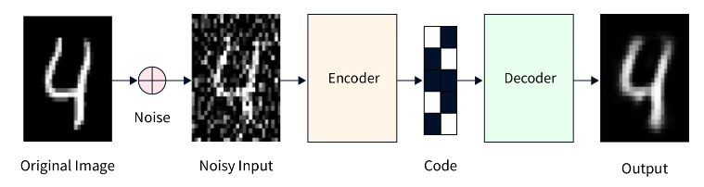
Denoising Autoencoders
In denoising autoencoders, we feed a noisy version of the image, where noise has been added via digital alterations. The noisy image is fed to the encoder-decoder architecture, and the output is compared with the ground truth image.

Slide 18
Architecture of Denoising Autoencoders
The architecture of a denoising autoencoder (DAE) is similar to that of a standard autoencoder. It consists of an encoder, which maps the input data to a lower-dimensional representation, or encoding, and a decoder, which maps the encoding back to the original data space.
Encoder:
Encoder is a neural network with one or more hidden layers.
It takes noisy data as input and outputs an encoding.
Encoding has fewer dimensions than the input data, so the encoder is a compression function.

Slide 19
Architecture of Denoising Autoencoders
Decoder:
Decoder is an expansion function that reconstructs original data from compressed encoding.
Input to the decoder is the encoding from an encoder, and output is a reconstruction of the original data.
Decoder is a neural network with one or more hidden layers.

Slide 20
Architecture of Denoising Autoencoders
During training, the DAE is given a set of clean input examples and the corresponding noisy versions of these examples. The goal is to learn a function that maps the noisy input to the clean output using the encoder-decoder architecture. This is typically done using a reconstruction loss function that measures the difference between the clean input and the reconstructed output. The DAE is trained to minimize this loss by updating the weights of the encoder and decoder through backpropagation.

Slide 21
Application of DAE
Denoising autoencoders (DAEs) have many applications in computer vision, speech processing, and natural language processing. Some examples include:
Image denoising: DAEs can be used to remove noise from images, such as Gaussian noise or salt-and-pepper noise.
Fraud detection: DAEs can be used to identify fraudulent transactions by learning to reconstruct normal transactions from noisy versions.

Slide 22
Application of DAE
Data imputation: DAEs can impute missing values in a dataset by learning to reconstruct the missing values from the remaining data.
Data compression: DAEs can compress data by learning a compact data representation in the encoding space.
Anomaly detection: DAEs can identify anomalies in a dataset by learning to reconstruct normal data and then flagging difficult inputs as potentially abnormal.

Slide 23
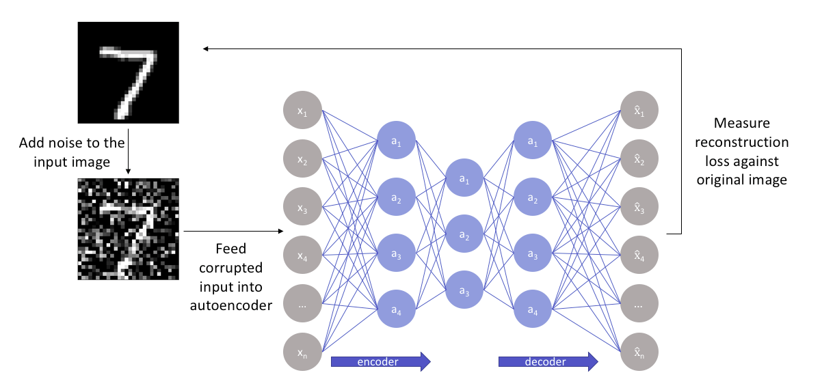
Denoising Autoencoders

Slide 24
Denoising Autoencoders

Slide 25
Sparse autoencoders
A sparse autoencoder is simply an autoencoder whose training criterion involves a sparsity penalty.
The idea behind Sparse Autoencoders is that we can achieve an information bottleneck (same information with fewer neurons) without reducing the number of neurons in the hidden layers. The number of neurons in the hidden layer can be greater than the number in the input layer.
According to the sparsity constraint, only some percentage of nodes can be active in a hidden layer. The neurons with output close to 1 are active, whereas the neurons close to 0 are in-active neurons.

Slide 26
Sparse autoencoders
Regularization in sparse autoencoders is a technique used to control the learning process and encourage the network to produce sparse representations in the hidden layers.
The idea is to introduce additional constraints or penalties during training that guide the autoencoder to use only a subset of its neurons for each input, resulting in a sparse activation pattern. This helps in learning more meaningful and informative features while preventing overfitting.

Slide 27
Sparse autoencoders
L1 Regularization: L1 regularization adds a penalty term to the loss function that is proportional to the absolute values of the weights. This encourages many weights to become exactly zero, effectively forcing some neurons to be inactive for certain inputs and promoting sparsity.
Kullback-Leibler (KL) Divergence Regularization: KL divergence regularization imposes a constraint on the activations of the hidden units to follow a specific target distribution, often a Bernoulli distribution. This encourages the activation of neurons to be either close to zero or one, leading to sparsity.

Slide 28
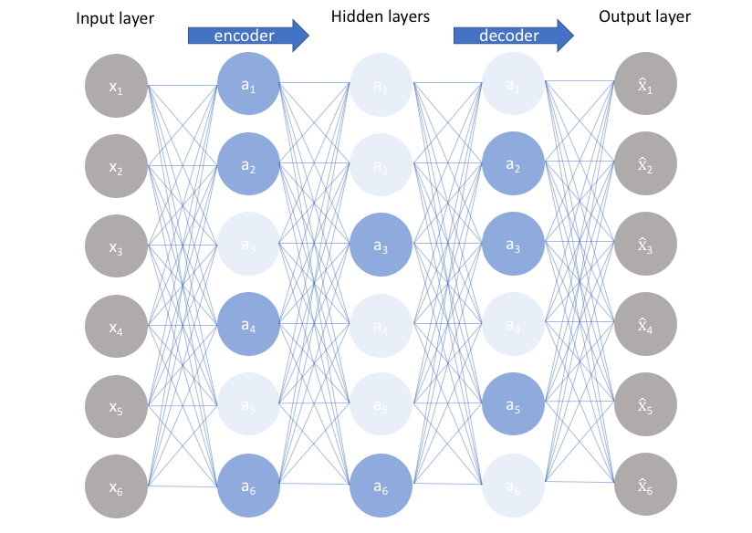
Sparse autoencoders

Slide 29
2. Sparse autoencoders
Applications:
Dimensionality Reduction: Sparse autoencoders can be used to perform dimensionality reduction on high-dimensional data. By learning a compact representation of the input data in the hidden layers, they can help reduce the amount of data while preserving important features.
Data Compression: Sparse autoencoders can be used for data compression, where the network learns a compact representation of the input data. This compressed representation can be stored or transmitted more efficiently than the original data

Slide 30
2. Sparse autoencoders
Applications:
Collaborative Filtering: In recommendation systems, sparse autoencoders can learn representations of users and items based on their interactions in a user-item matrix. These learned representations can then be used to provide personalized recommendations.
Document Representation: For natural language processing tasks, sparse autoencoders can be used to learn meaningful representations of text documents. These representations can capture semantic information and assist in tasks like document classification and clustering.

Slide 31
Deep Autoencoders
A deep autoencoder extends the concept of a simple autoencoder by adding more layers, making it capable of learning more complex and abstract representations of input data.
It is composed of two, symmetrical deep-belief networks-
First four or five shallow layers representing the encoding half of the net.
The second set of four or five layers that make up the decoding half.

Slide 32
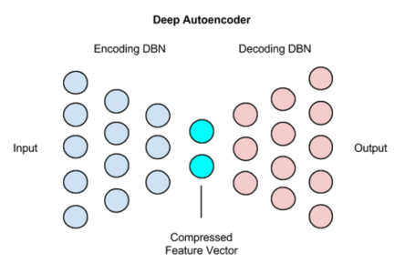
Deep Autoencoders
Use cases of Deep Autoencoders
Image Search
Data Compression
Topic Modeling & Information Retrieval (IR)

Slide 33
Deep Autoencoders
Representation Learning in Natural Language Processing: Deep autoencoders can be applied to learn representations of text data, which can then be used for tasks like sentiment analysis, machine translation, and text classification.
Drug Discovery: Deep autoencoders can help analyze molecular data, predict chemical properties, and assist in drug discovery by learning meaningful molecular representations
Image Search
Data Compression
Information Retrieval (IR)

Slide 34
Deep Autoencoders
Encoder: The encoder part of the deep autoencoder takes the input data and maps it to a series of hidden layers, gradually reducing the dimensionality of the data. Each hidden layer learns to capture higher-level features and abstractions.
Bottleneck Layer: The bottleneck layer is the middle layer of the network where the data is represented in a lower-dimensional space. This layer captures the most important features of the input data.
Decoder: The decoder part of the deep autoencoder takes the bottleneck representation and maps it back to the original input dimensionality through a series of hidden layers. This process aims to reconstruct the input data as accurately as possible.

Slide 35
Variational Autoencoders
A Variational Autoencoder (VAE) is a deep learning model that can generate new data samples. It comprises two parts: an encoder network and a decoder network. The encoder network maps the input data to a lower-dimensional latent space, and the decoder network maps the latent representation back to the original data space.
Variational Autoencoders (VAEs) are generative models that learn a dataset's underlying probability distribution and generate new samples.

Slide 36
Variational Autoencoders
They use an encoder-decoder architecture, where the encoder maps the input data to a latent representation, and the decoder tries to reconstruct the original data from this latent representation. The VAE is trained to minimize the difference between the original data and the reconstructed data, allowing it to learn the underlying distribution of the data and generate new samples that follow that same distribution.

Slide 37
Variational Autoencoders
One of the key advantages of VAEs is that they can generate new data samples similar to the training data. This is because the latent space learned by the VAE is continuous, which allows the decoder to generate new data points that are smoothly interpolated between the training data points.
VAEs have some applications, including image generation, text generation, and density estimation. They have also been used in various fields, including computer vision, natural language processing, and finance.

Slide 38
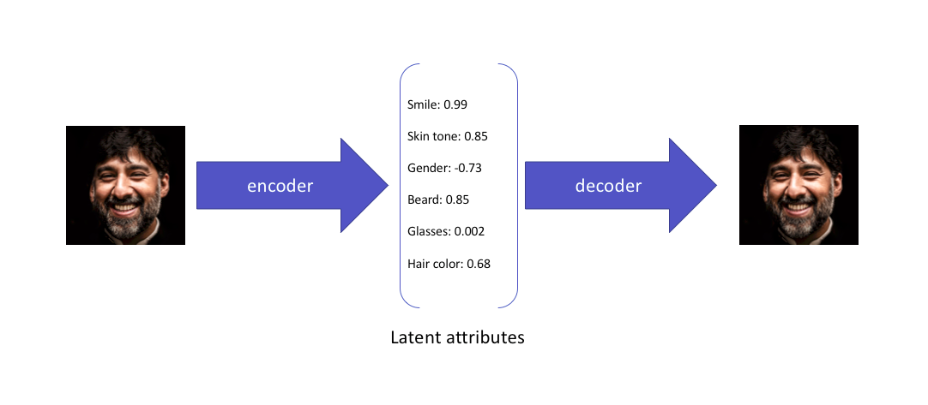
Variational Autoencoders
For example :
This is what a variational autoencoder would learn from the input:

Slide 39
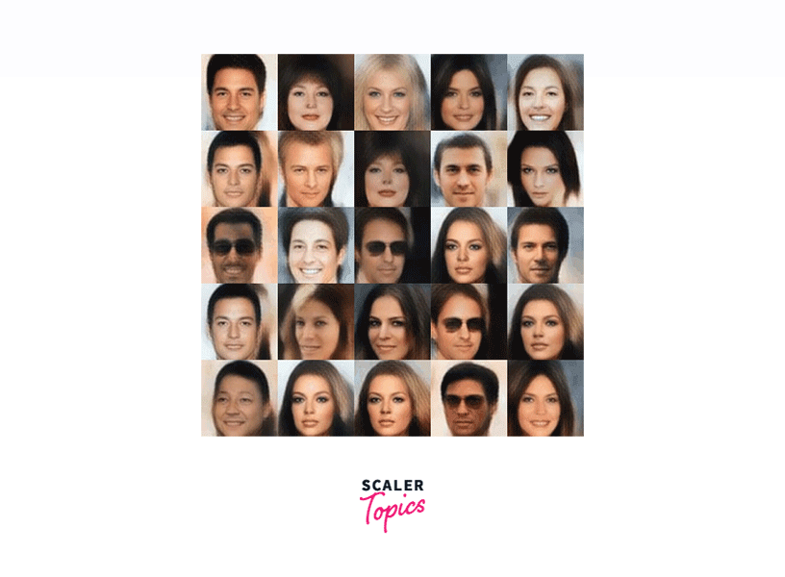

Slide 40
Applications
Data Generation and Synthesis: VAEs can generate new data samples that resemble the training data. This has applications in creating realistic images, text, music, and other types of creative content.
Image-to-Image Translation: VAEs can be used for tasks like image style transfer, where they learn the latent representations of images and then manipulate these representations to generate images in different styles or domains.
Data Augmentation: VAEs can generate augmented versions of existing data, aiding in improving the performance of machine learning models by increasing the diversity of the training dataset.

Slide 41
Applications
Natural Language Generation: In natural language processing, VAEs can generate coherent and contextually relevant text, which is useful for chatbots, content generation, and creative writing.
Style Transfer and Image Manipulation: VAEs can be used to separate content and style information from images, allowing users to manipulate and transfer artistic styles between images.
Image Inpainting: VAEs can fill in missing parts of an image, which has applications in image editing, restoration, and completion.
Super-Resolution Imaging: VAEs can be used to enhance the resolution of images by learning a mapping between low-resolution and high-resolution images.

Slide 42
Generative Adversarial Networks(GANs)
Generative Adversarial Networks or GANs are types of Neural Networks used for Unsupervised learning
GANs were introduced in 2014 by Ian J. Goodfellow and teammates.
Generative which means that there is a network that is constantly generating new data and the second word is Adversarial which means that it involves two networks opposing each other and Network simply means an order of data that is going ahead and generate new data.

Slide 43
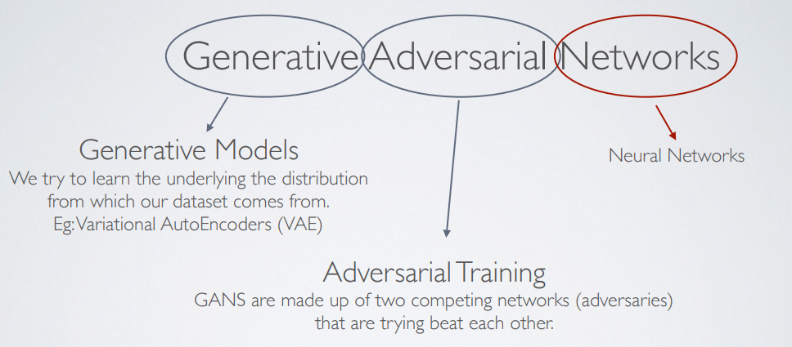
Generative Adversarial Networks(GANs)

Slide 44
Generative Adversarial Networks(GANs)
It consists of 2 models that automatically discover and learn the patterns in input data.
GANs consists of two networks, a Generator G(x), and a Discriminator D(x). They both play an adversarial game where the generator tries to fool the discriminator by generating data similar to those in the training set. The Discriminator tries not to be fooled by identifying fake data from real data. They both work simultaneously to learn and train complex data like audio, video or image files.

Slide 45
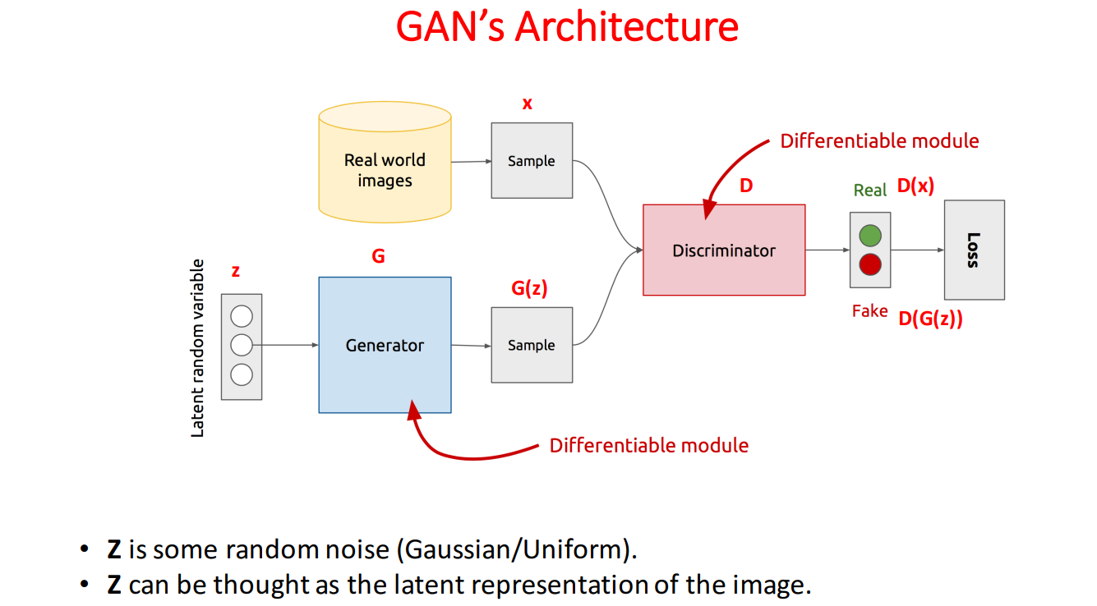

Slide 46
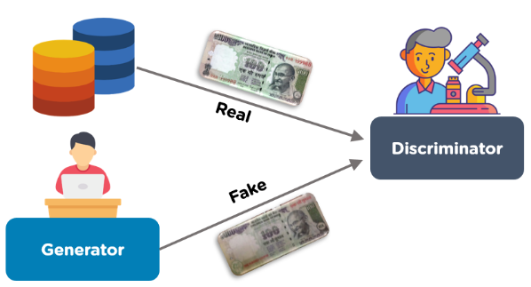
GAN
Shown below is an example of a GAN. There is a database that has real 100 rupee notes. The generator neural network generates fake 100 rupee notes. The discriminator network will help identify the real and fake notes.

Slide 47
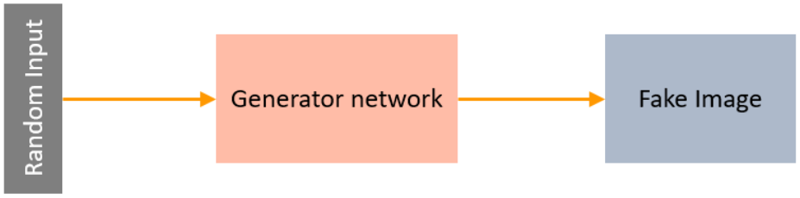
What is a Generator?
A Generator in GANs is a neural network that creates fake data to be trained on the discriminator. It learns to generate plausible data. The generated examples/instances become negative training examples for the discriminator. It takes a fixed-length random vector carrying noise as input and generates a sample.
The main aim of the Generator is to make the discriminator classify its output as real.
Notes:
Plausible- seeming likely to be true, or able to be believed

Slide 48
What is a Generator?
The part of the GAN that trains the Generator includes:
noisy input vector
generator network, which transforms the random input into a data instance
discriminator network, which classifies the generated data
generator loss, which penalizes the Generator for failing to dolt the discriminator

Slide 49
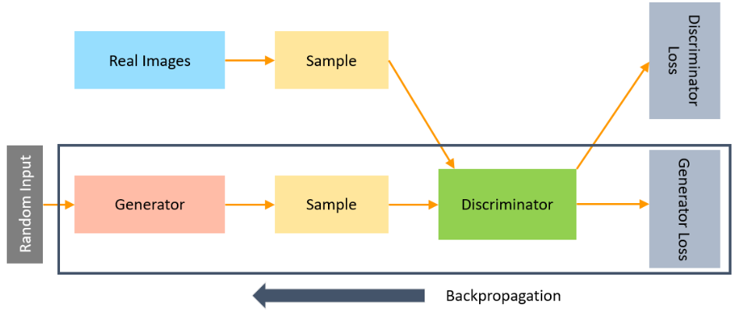
What is a Generator?
The backpropagation method is used to adjust each weight in the right direction by calculating the weight's impact on the output. It is also used to obtain gradients and these gradients can help change the generator weights.
Notes:
Plausible- seeming likely to be true, or able to be believed

Slide 50
What is a Discriminator?
The Discriminator is a neural network that identifies real data from the fake data created by the Generator. The discriminator's training data comes from different two sources:
The real data instances, such as real pictures of birds, humans, currency notes, etc., are used by the Discriminator as positive samples during training.
The fake data instances created by the Generator are used as negative examples during the training process.

Slide 51
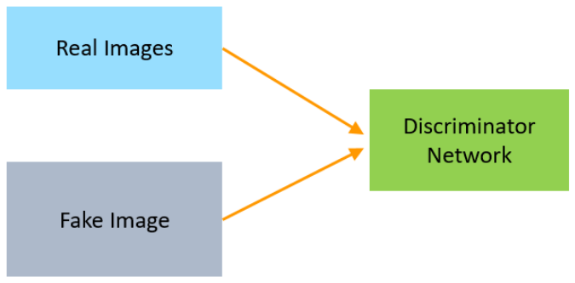
What is a Discriminator?

Slide 52
What is a Discriminator?
In the process of training the discriminator, the discriminator classifies both real data and fake data from the generator. The discriminator loss penalizes the discriminator for misclassifying a real data instance as fake or a fake data instance as real.
The discriminator updates its weights through backpropagation from the discriminator loss through the discriminator network.

Slide 53
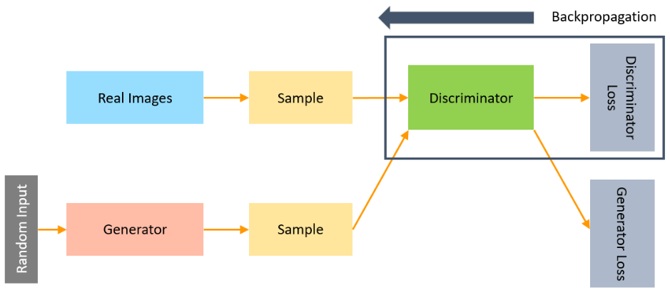
What is a Discriminator?

Slide 54
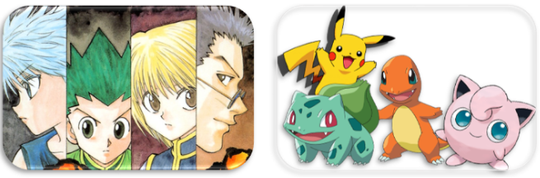
Application of GANs
With the help of DCGANs, you can train images of cartoon characters for generating faces of anime characters as well as Pokemon characters.

Slide 55
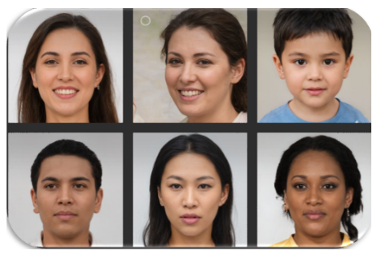
Application of GANs
GANs can be trained on the images of humans to generate realistic faces. The faces that you see below have been generated using GANs and do not exist in reality.

Slide 56
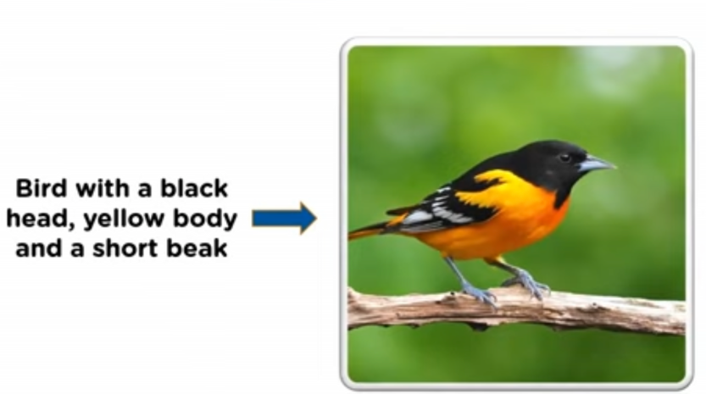
Application of GANs
GANs can build realistic images from textual descriptions of objects like birds, humans, and other animals. We input a sentence and generate multiple images fitting the description.

Slide 57
Steps for Training GAN
Define the problem
Choose the architecture of GAN
Train discriminator on real data
Generate fake inputs for the generator
Train discriminator on fake data
Train generator with the output of the discriminator

Slide 58
Types of GANs.
Vanilla GANs
Deep Convolutional GANs (DCGANs)
Conditional GANs
Super Resolution GANs

